Slide 1
ECE 884 Deep Learning
Lecture 17-18: Recurrent Neural Networks (RNN)
03/23/25/2021

Slide 2
Review of last lecture
Convolutional Neural Network (ConvNet)

Slide 3
Today’s lecture
Recurrent Neural Network (RNN)
Word Embeddings
Simple / Vanilla RNN
Long Short Term Memory (LSTM)
Making RNNs More Effective
Notes:
To add:
Weight initialization
Batch normalization

Slide 4
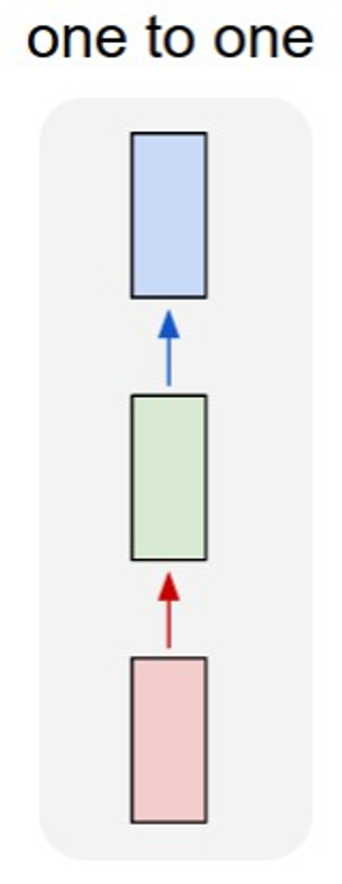
So far: “Feedforward” Neural Networks
Limitations of FC Nets and ConvNets:
Process a paragraph as a whole.
Fixed-size input (e.g., image).
Fixed-size output (e.g., predicted probabilities).
e.g. Image classification
Image -> Label

Slide 5
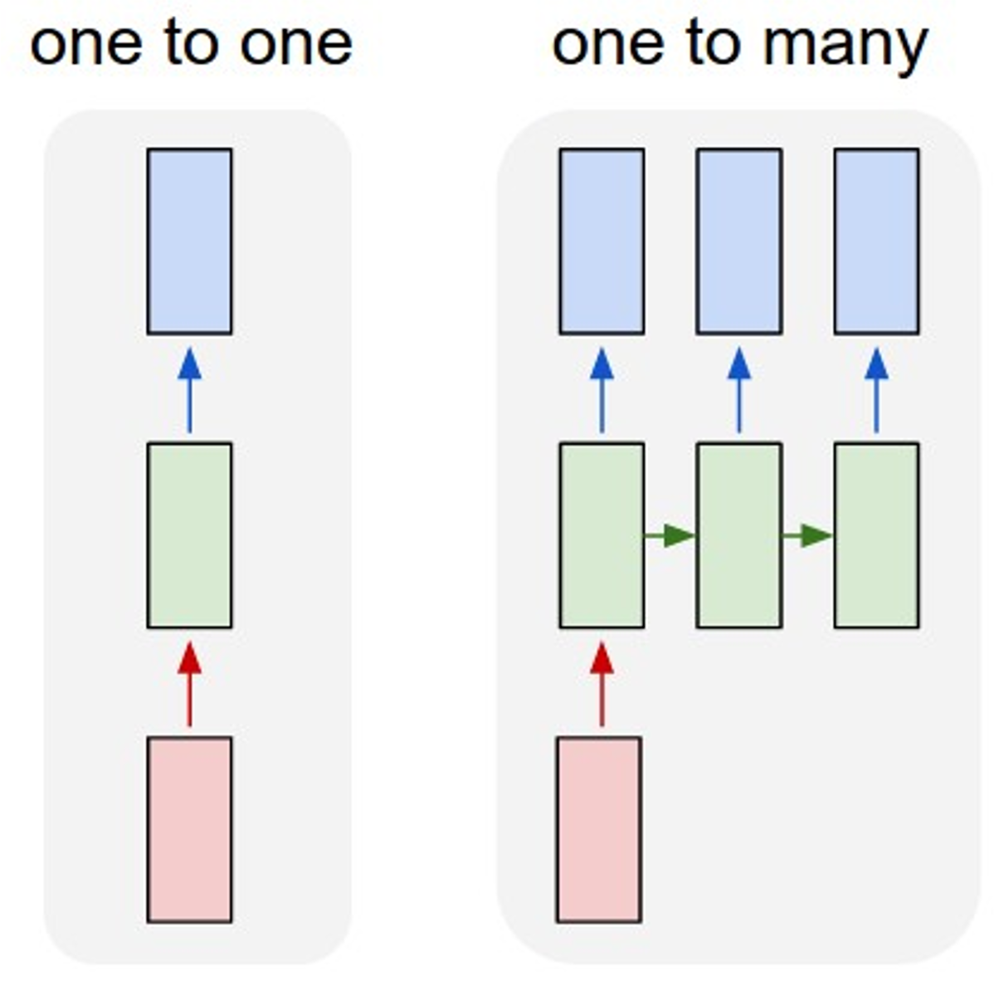
How to model sequential data?
e.g. Image Captioning: Image -> sequence of words

Slide 6
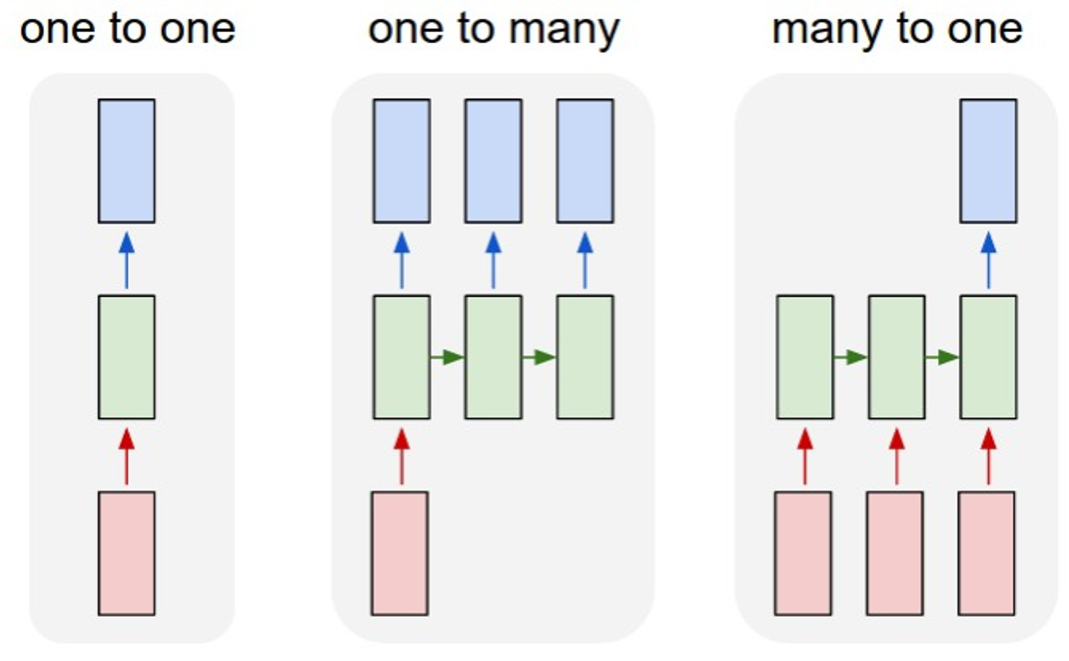
How to model sequential data?
e.g. Video classification:
Sequence of images -> label

Slide 7
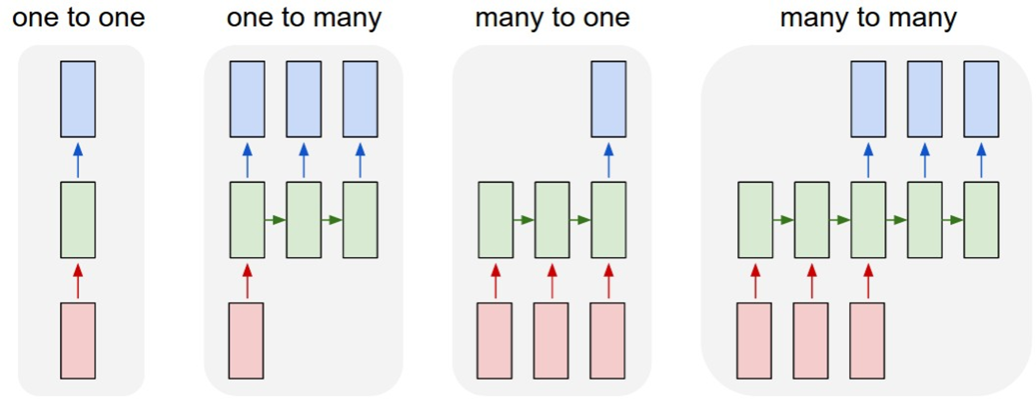
How to model sequential data?
e.g. Machine Translation:
Sequence of words -> Sequence of words

Slide 8
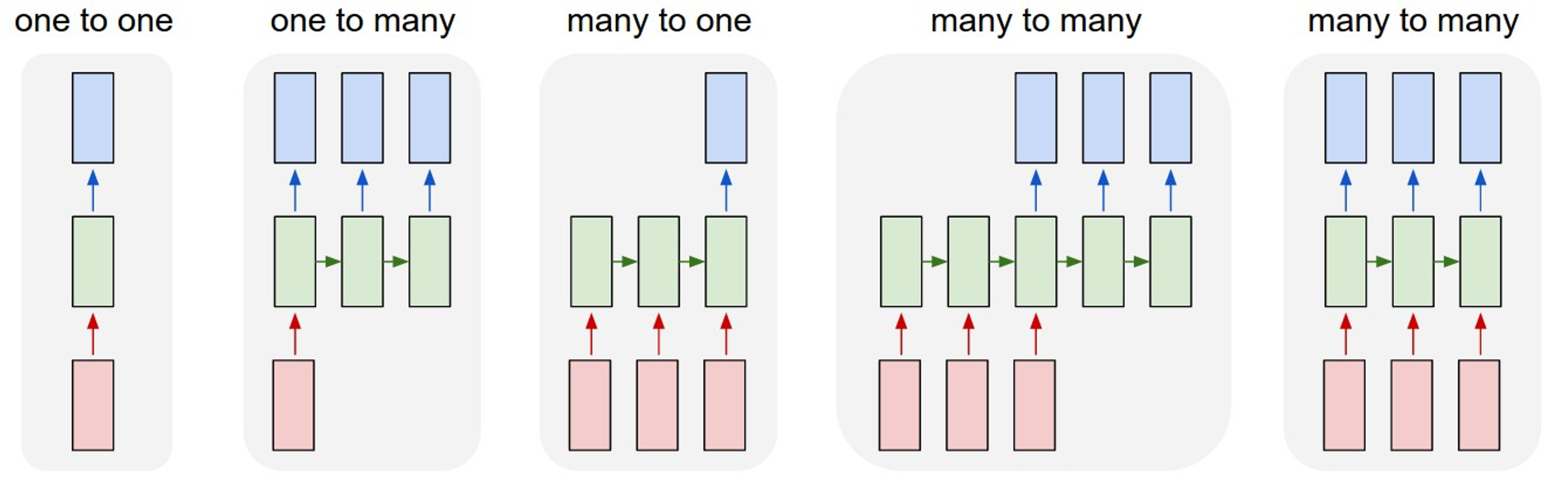
How to model sequential data?
e.g. Per-frame video classification:
Sequence of images -> Sequence of labels

Slide 9
Representing Sequential Data

Slide 10
Step 1: Tokenization (Text to Words)
We are given a piece of text (string), e.g.,
S = “… to be or not to be…”.
Break the string (string) into a list of words:
L = […, to, be, or, not, to, be, …],

Slide 11
Step 2: Count Word Frequencies
Key (word) | Value (frequency)
Build a dictionary (e.g., hash table) to count words’ frequencies.
Initially, the dictionary is empty.

Slide 12
Step 2: Count Word Frequencies
Key (word) | Value (frequency)
a | 219
to | 398
hamlet | 5
be | 131
not | 499
prince | 12
kill | 31
Update the dictionary in this way:
If word 𝑤 is not in the dictionary, add 𝑤, 1 to the dictionary.
If word 𝑤 is in the dictionary, increase its frequency counter.

Slide 13
Step 2: Count Word Frequencies
Key (word) | Value (frequency)
a | 219
to | 398
hamlet | 5
be | 131
not | 499
prince | 12
kill | 31
Update the dictionary in this way:
If word 𝑤 is not in the dictionary, add 𝑤, 1 to the dictionary.
If word 𝑤 is in the dictionary, increase its frequency counter.
... | to | be | or | not | to | be | ...

Slide 14
Step 2: Count Word Frequencies
Key (word) | Value (frequency)
a | 219
to | 398
hamlet | 5
be | 131
not | 499
prince | 12
kill | 31
Update the dictionary in this way:
If word 𝑤 is not in the dictionary, add 𝑤, 1 to the dictionary.
If word 𝑤 is in the dictionary, increase its frequency counter.
... | to | be | or | not | to | be | ...
Word “to” is in the dictionary.

Slide 15
Step 2: Count Word Frequencies
Key (word) | Value (frequency)
a | 219
to | 399
hamlet | 5
be | 131
not | 499
prince | 12
kill | 31
Update the dictionary in this way:
If word 𝑤 is not in the dictionary, add 𝑤, 1 to the dictionary.
If word 𝑤 is in the dictionary, increase its frequency counter.
... | to | be | or | not | to | be | ...
Word “to” is in the dictionary.
Increase its counter.

Slide 16
Step 2: Count Word Frequencies
Key (word) | Value (frequency)
a | 219
to | 399
hamlet | 5
be | 131
not | 499
prince | 12
kill | 31
Update the dictionary in this way:
If word 𝑤 is not in the dictionary, add 𝑤, 1 to the dictionary.
If word 𝑤 is in the dictionary, increase its frequency counter.
... | to | be | or | not | to | be | ...
Word “be” is in the dictionary.

Slide 17
Step 2: Count Word Frequencies
Key (word) | Value (frequency)
a | 219
to | 399
hamlet | 5
be | 132
not | 499
prince | 12
kill | 31
Update the dictionary in this way:
If word 𝑤 is not in the dictionary, add 𝑤, 1 to the dictionary.
If word 𝑤 is in the dictionary, increase its frequency counter.
... | to | be | or | not | to | be | ...
Word “be” is in the dictionary.
Increase its counter.

Slide 18
Step 2: Count Word Frequencies
Key (word) | Value (frequency)
a | 219
to | 399
hamlet | 5
be | 132
not | 499
prince | 12
kill | 31
Update the dictionary in this way:
If word 𝑤 is not in the dictionary, add 𝑤, 1 to the dictionary.
If word 𝑤 is in the dictionary, increase its frequency counter.
... | to | be | or | not | to | be | ...
Word “or” is not in the dictionary.

Slide 19
Step 2: Count Word Frequencies
Key (word) | Value (frequency)
a | 219
to | 399
hamlet | 5
or | 1
be | 132
not | 499
prince | 12
kill | 31
Update the dictionary in this way:
If word 𝑤 is not in the dictionary, add 𝑤, 1 to the dictionary.
If word 𝑤 is in the dictionary, increase its frequency counter.
... | to | be | or | not | to | be | ...
Word “or” is not in the dictionary.
Add (“or”, 1) to the dictionary.

Slide 20
Step 2: Count Word Frequencies
Key (word) | Value (frequency)
a | 219
to | 399
hamlet | 5
or | 1
be | 132
not | 499
prince | 12
kill | 31
Sort the table so that the frequency is in the descending order.

Slide 21
Step 2: Count Word Frequencies
Key (word) | Value (frequency)
not | 499
to | 399
a | 219
be | 132
kill | 31
prince | 12
hamlet | 5
or | 1
Sort the table so that the frequency is in the descending order.

Slide 22
Step 2: Count Word Frequencies
Key (word) | Value (frequency)
not | 499
to | 399
a | 219
be | 131
kill | 31
prince | 12
hamlet | 5
or | 1
Sort the table so that the frequency is in the descending order.
Replace “frequency” by “index” (starting from 1.)

Slide 23
Step 2: Count Word Frequencies
Key (word) | Value (index)
not | 1
to | 2
a | 3
be | 4
kill | 5
prince | 6
hamlet | 7
or | 8
Sort the table so that the frequency is in the descending order.
Replace “frequency” by “index” (starting from 1.)
The number of unique words is called “vocabulary”.

Slide 24

Step 3: One-Hot Encoding
Key (word) | Value (index)
not | 1
to | 2
a | 3
be | 4
kill | 5
prince | 6
hamlet | 7
or | 8
Map every word to its index.
For example,
Words: [to, be, or, not, to, be]
Indices: [2, 4, 8, 1, 2, 4]

Slide 25
Step 3: One-Hot Encoding
Key (word) | Value (index)
not | 1
to | 2
a | 3
be | 4
kill | 5
prince | 6
hamlet | 7
or | 8
Map every word to its index.
For example,
Words: [to, be, or, not, to, be]
Indices: [2, 4, 8, 1, 2, 4]
Convert every index to a one-hot vector.
The one-hot vector’ dimension is the vocabulary.
Vocabulary means # of unique words in the dictionary.

Slide 26
Word Embedding: Word to Vector

Slide 27
How to map word to vector?
Word | Index
“movie” | 1
“good” | 2
“fun” | 3
“boring” | 4
⋯ | ⋯

Slide 28
One-Hot Encoding
First, represent words using one-hot vectors.
Suppose the dictionary contains 𝑣 unique words (vocabulary= 𝑣).
Then the one-hot vectors are 𝑣-dimensional.
Word | Index | One-hot encoding
“movie” | 1 | 1, 0, 0, 0, 0, ⋯ , 0
“good” | 2 | 0, 1, 0, 0, 0, ⋯ , 0
“fun” | 3 | 0, 0, 1, 0, 0, ⋯ , 0
“boring” | 4 | 0, 0, 0, 1, 0, ⋯ , 0
⋯ | ⋯ | ⋯

Slide 29
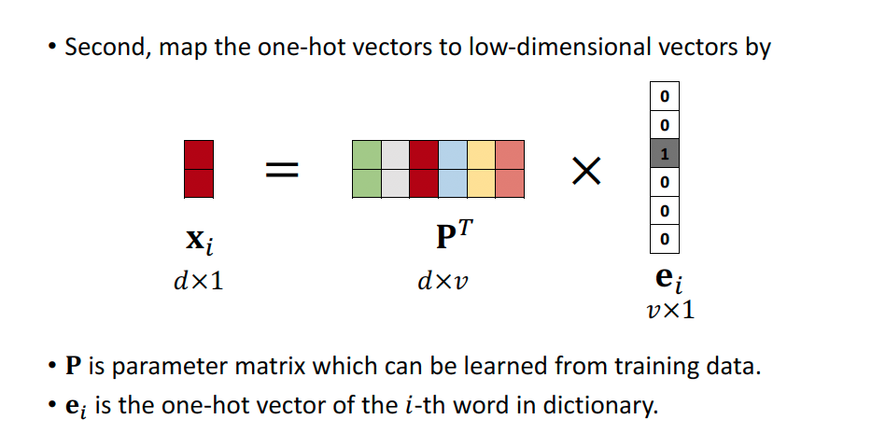
Word Embedding

Slide 30
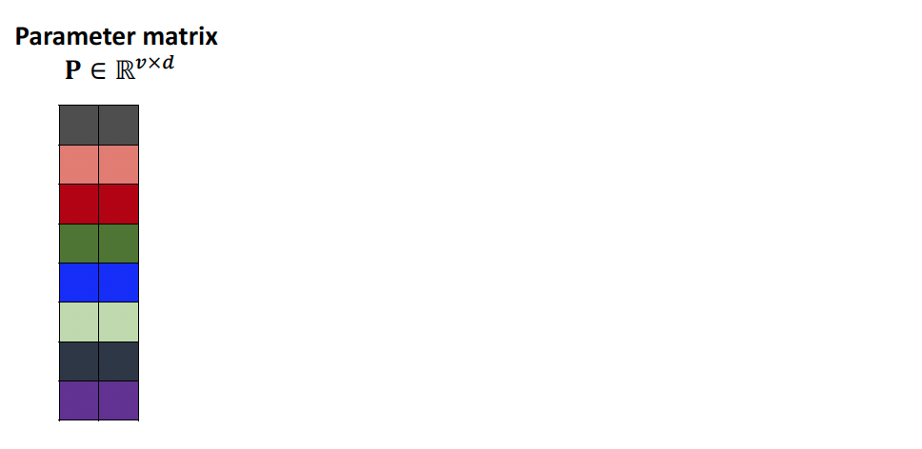
How to interpret the parameter matrix?

Slide 31
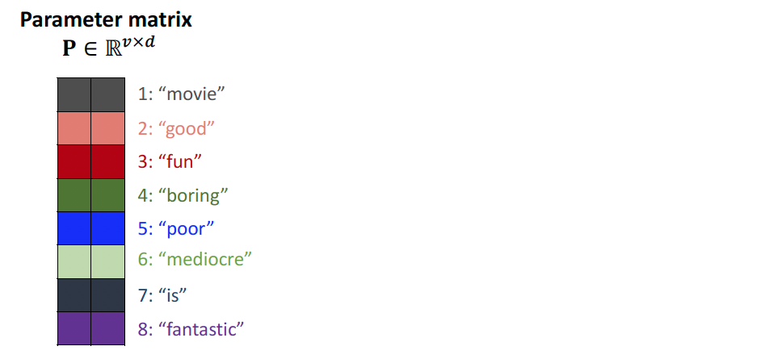
How to interpret the parameter matrix?

Slide 32
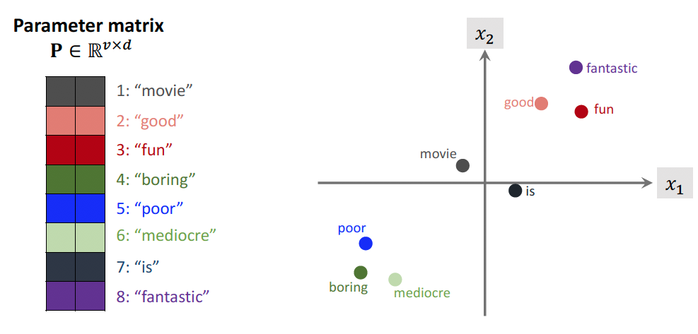
How to interpret the parameter matrix?
Notes:
Word2vec

Slide 33
Recurrent Neural Networks
y
Key idea: RNNs have an “internal state” that is updated as a sequence is processed
RNN
x

Slide 34
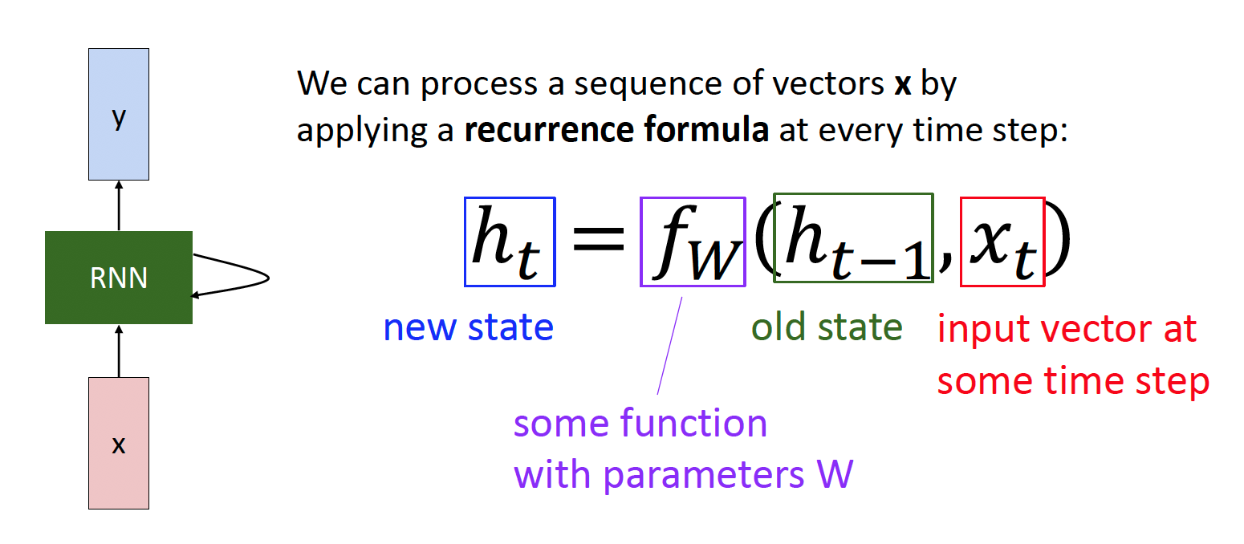
Recurrent Neural Networks

Slide 35
Recurrent Neural Networks
Notice: the same function and the same set of parameters are used at every time step.

Slide 36
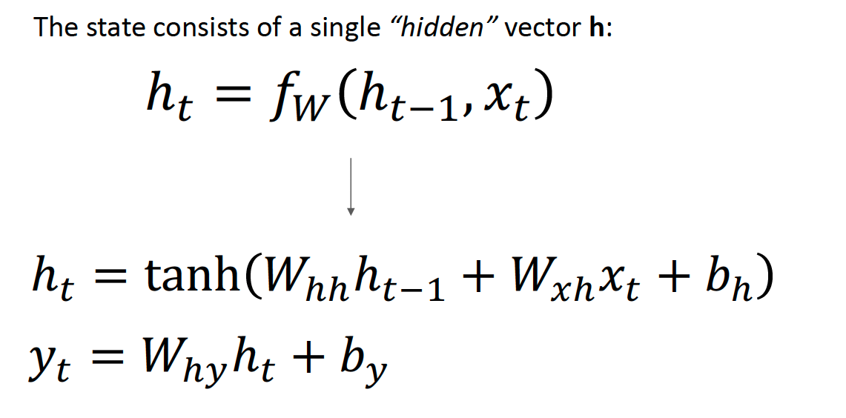
(Vanilla) Recurrent Neural Networks
y
RNN
x

Slide 37

Unfold
state
⋯
parameter
Word embedding
word
the
cat
sat
⋯
mat

Slide 38

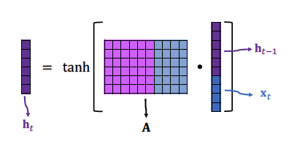
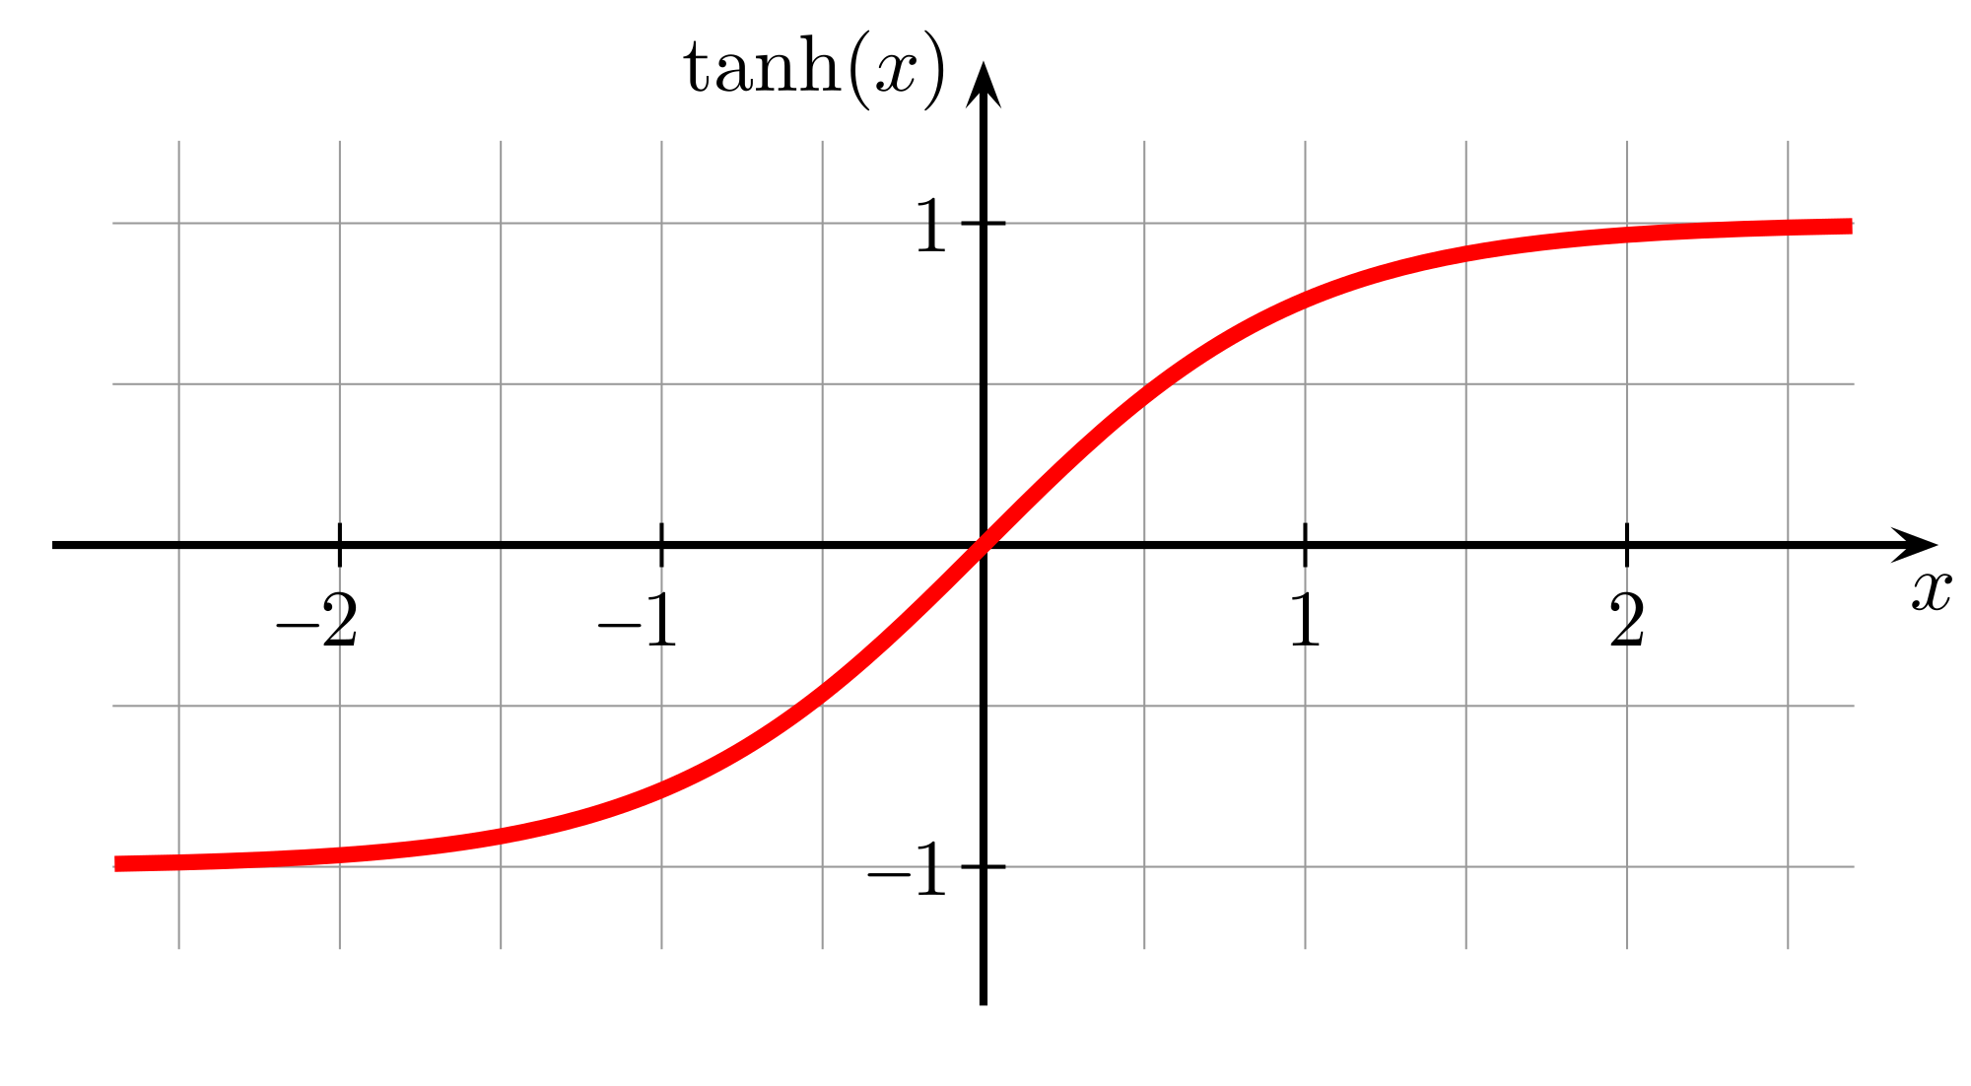
A Closer Look
hyperbolic tangent function

Slide 39
A Closer Look
Question: Why do we need the tanh function?
hyperbolic tangent function

Slide 40
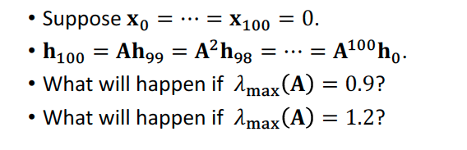
A Closer Look
Question: Why do we need the tanh function?
hyperbolic tangent function

Slide 41
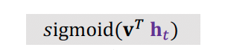
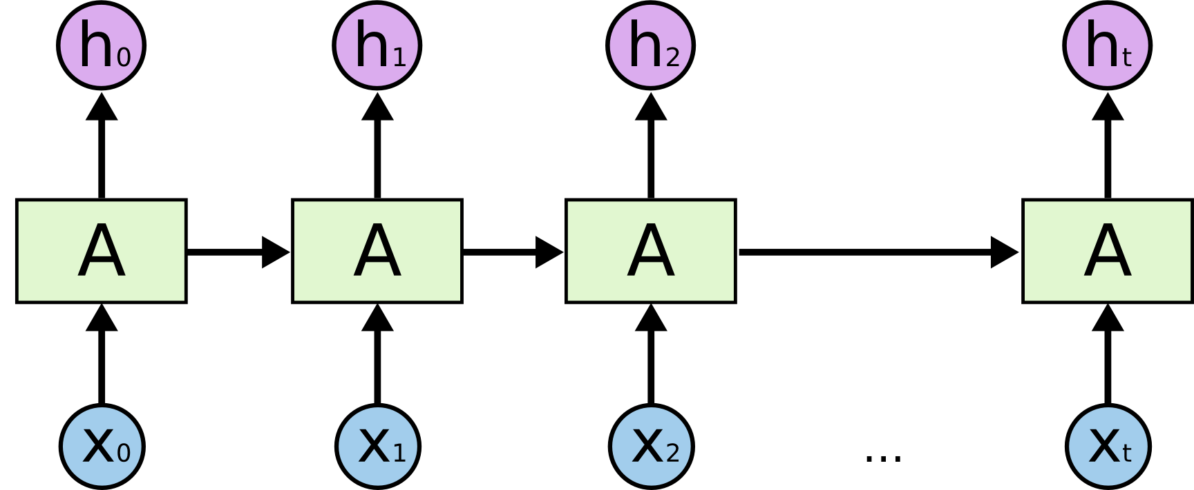
Simple RNN for Classification
⋯
i
love
the
⋯
much

Slide 42
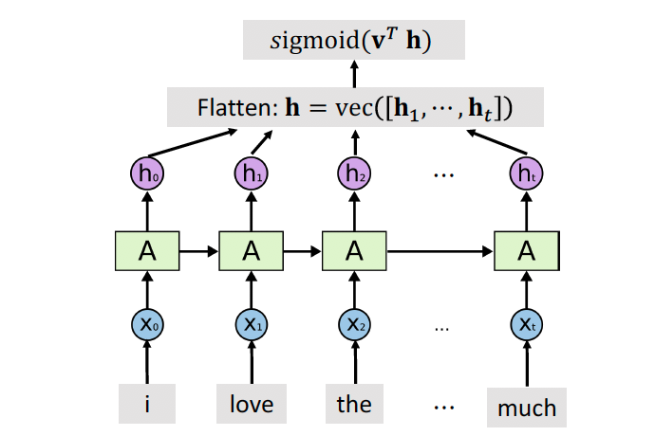
Simple RNN for Classification

Slide 43
Shortcomings of Simple RNN

Slide 44
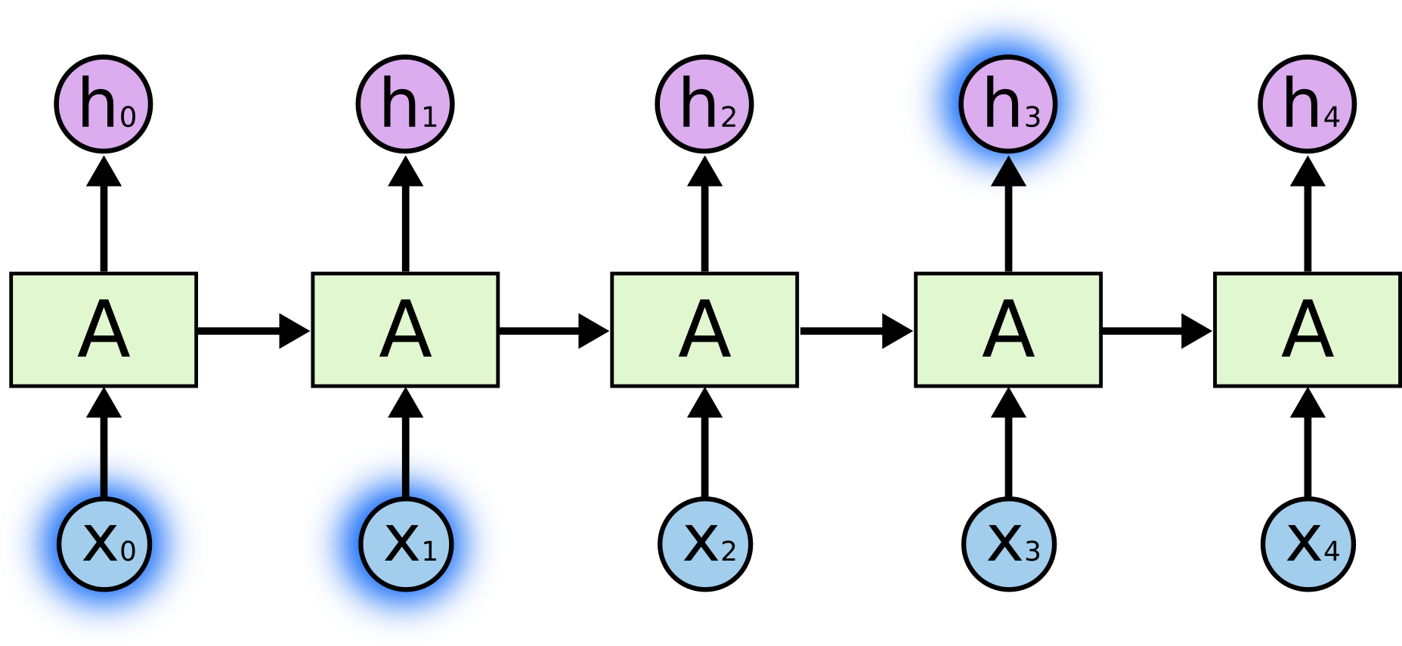
SimpleRNN is good at short-term dependence
Predicted next words:
sky
Input text:
clouds
are
in
the
Figures are from Christopher Olah’s blog: Understanding LSTM Networks.

Slide 45
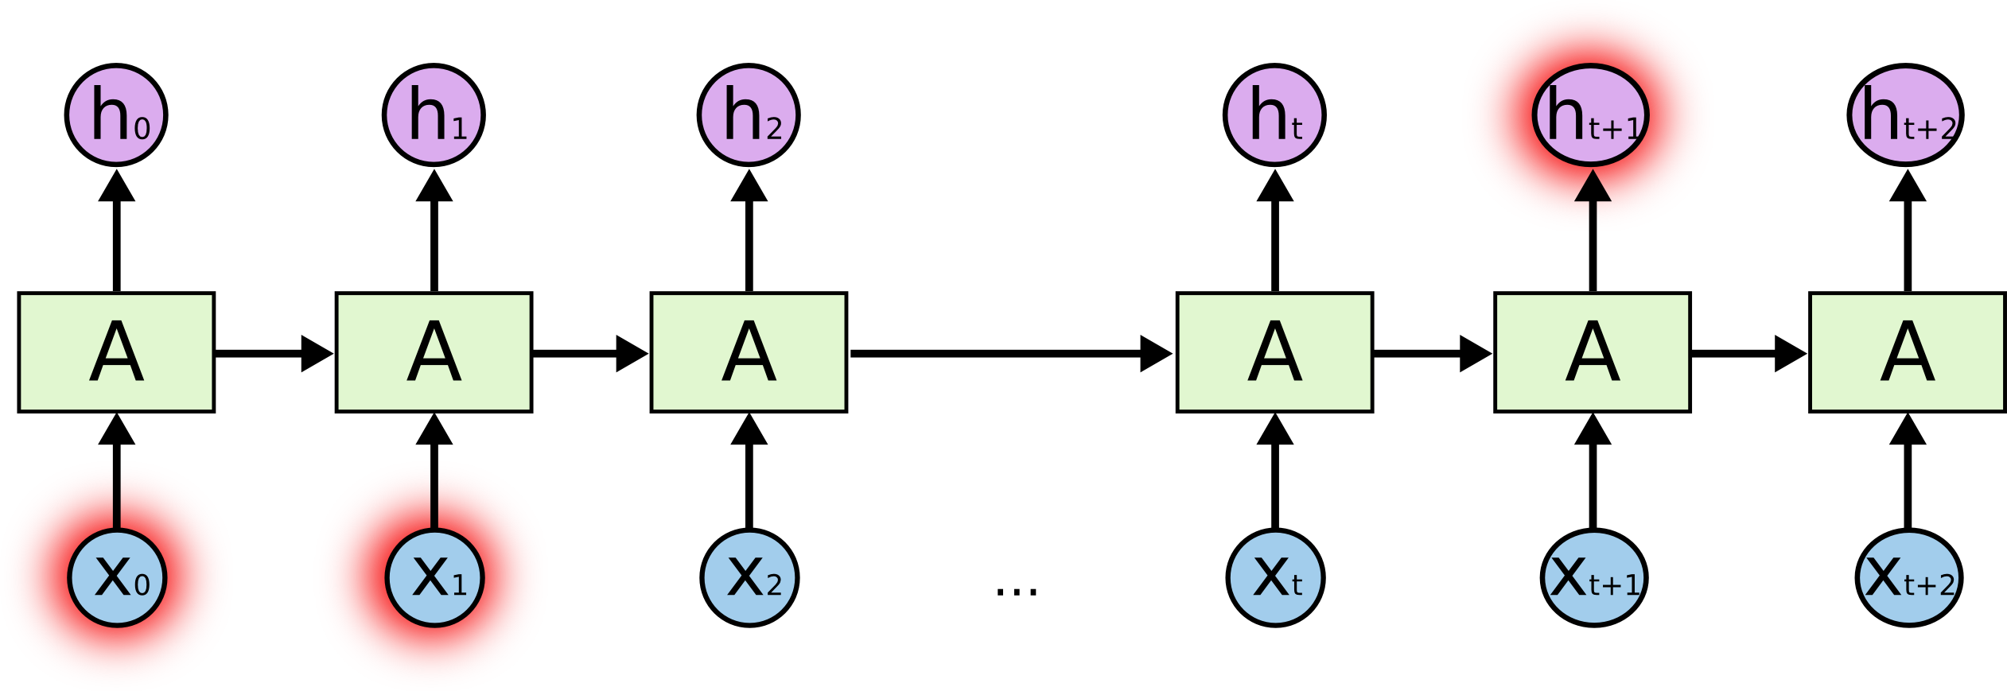
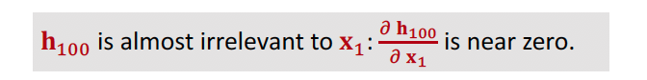
SimpleRNN is good at short-term dependence
Figures are from Christopher Olah’s blog: Understanding LSTM Networks.

Slide 46
SimpleRNN is good at short-term dependence
Predicted next words:
Chinese
Input text:
in
China
speak
fluent
Figures are from Christopher Olah’s blog: Understanding LSTM Networks.

Slide 47
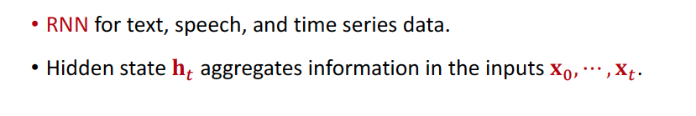
Summary

Slide 48
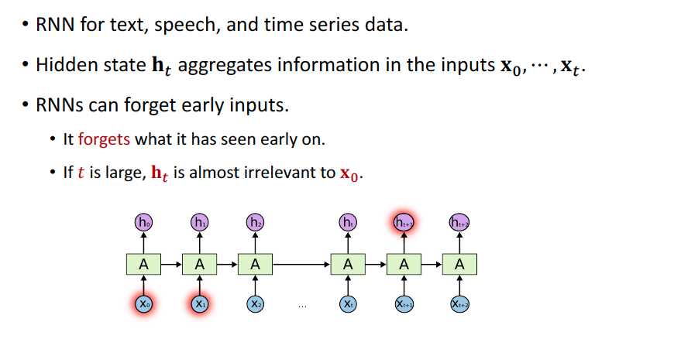
Summary

Slide 49
LSTM Model
Reference
Hochreiter and Schmidhuber. Long short-term memory. Neural computation, 1997.

Slide 50

LSTM Networks
Simple RNN
LSTM
Figures are from Christopher Olah’s blog: Understanding LSTM Networks.

Slide 51
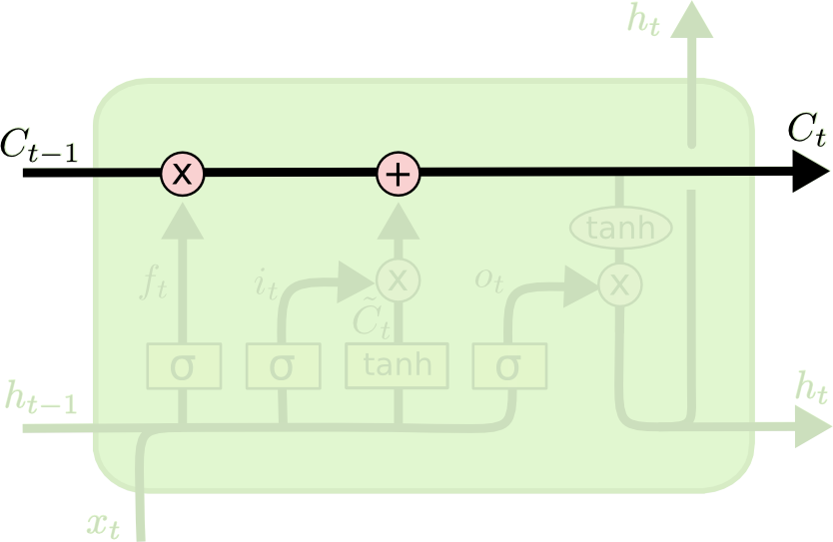
LSTM: Conveyor Belt
Conveyor belt: the past information directly flows to the future.
The Figure is from Christopher Olah’s blog: Understanding LSTM Networks.

Slide 52
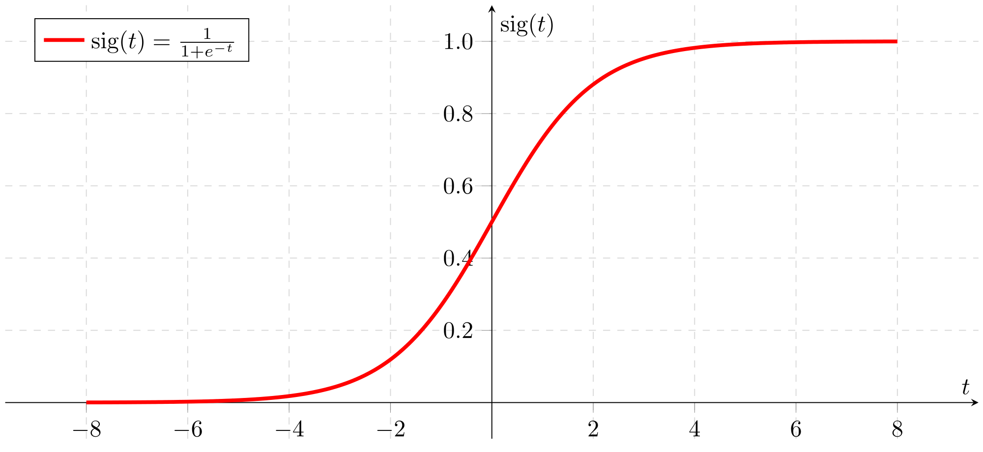
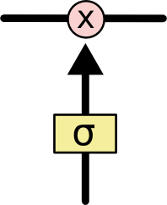
LSTM: Forget Gate
Elementwise multiplication of 2 vectors.
𝐜
𝐟
𝐚
Sigmoid function: between 0 and 1.

Slide 53
LSTM: Forget Gate
Elementwise multiplication of 2 vectors.
1
3
0
−2
0.73
0.95
0.5
0.12
𝐜
𝜎
=
𝐟
𝐚
𝐚
𝐟

Slide 54
LSTM: Forget Gate
Elementwise multiplication of 2 vectors.
0.9
0.2
−0.5
−0.1
0.5
0
1
0.8
0.45
0
−0.5
−0.08
𝐜
∘
=
𝐟
𝐚
𝐜
𝐟
output

Slide 55
LSTM: Forget Gate
Forget gate:
A value of zero means “let nothing through”.
A value of one means “let everything through!”
Elementwise multiplication of 2 vectors.
0.9
0.2
−0.5
−0.1
0.5
0
1
0.8
0.45
0
−0.5
−0.08
𝐜
∘
=
𝐟
𝐚
𝐜
𝐟
output

Slide 56
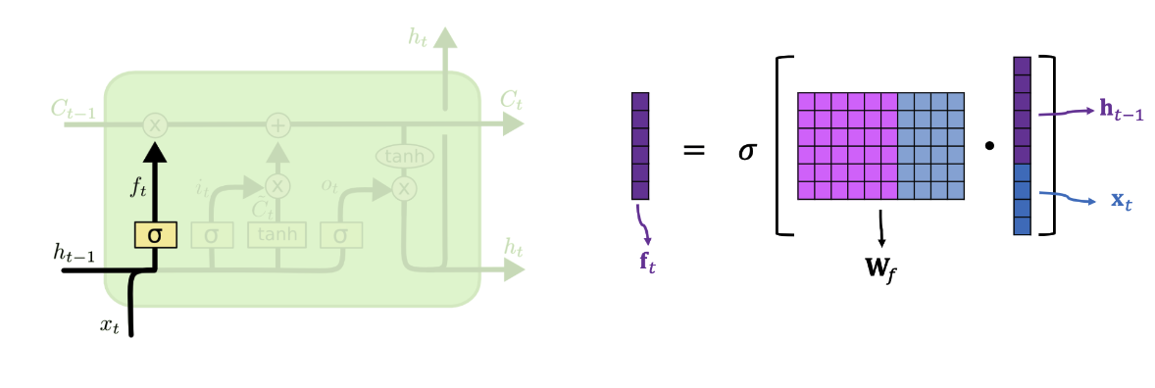
LSTM: Forget Gate
Forget gate f
A value of zero means “let nothing through”.
A value of one means “let everything through!”
The left figure is from Christopher Olah’s blog: Understanding LSTM Networks.

Slide 57
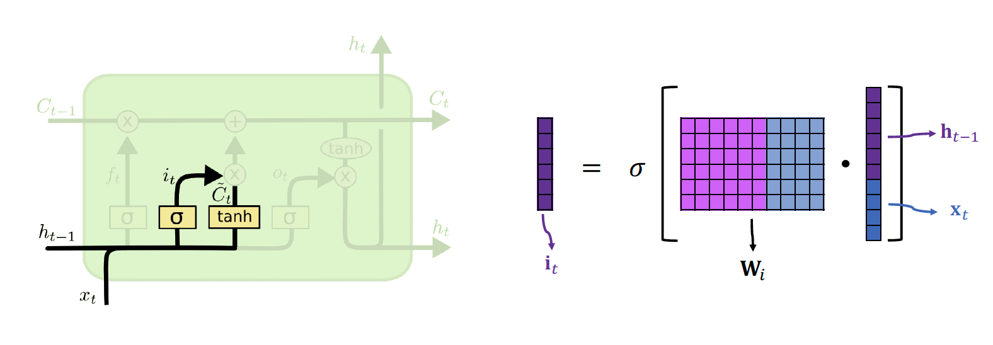
LSTM: Input Gate
Input gate i: d e. cides which values of the conveyor belt we’ll update.
The left figure is from Christopher Olah’s blog: Understanding LSTM Networks.

Slide 58
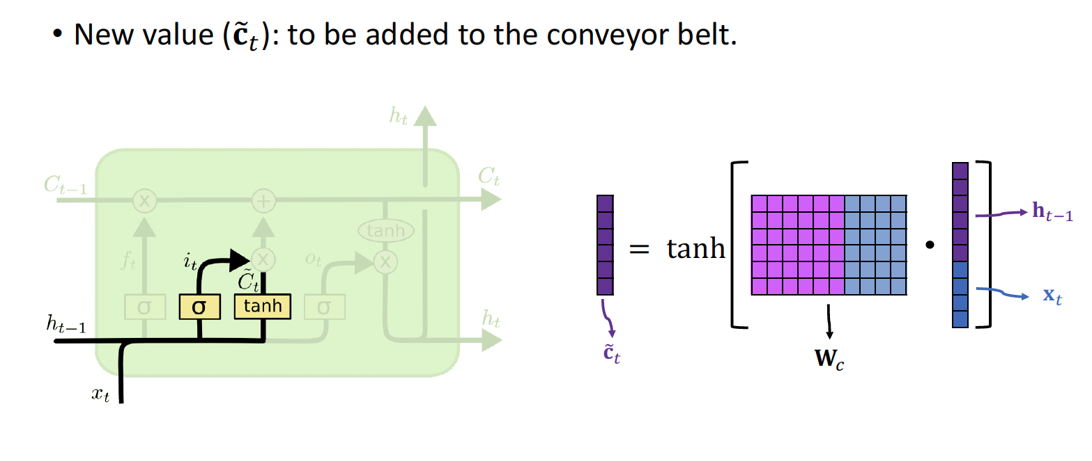
LSTM: New Value
The left figure is from Christopher Olah’s blog: Understanding LSTM Networks.

Slide 59
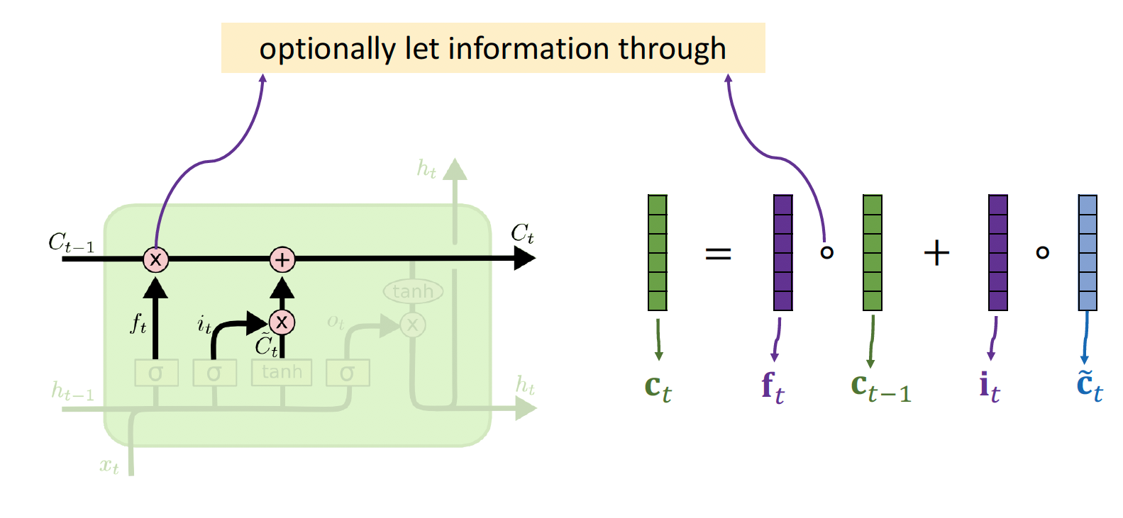
LSTM: Update the Conveyor Belt
The left figure is from Christopher Olah’s blog: Understanding LSTM Networks.

Slide 60
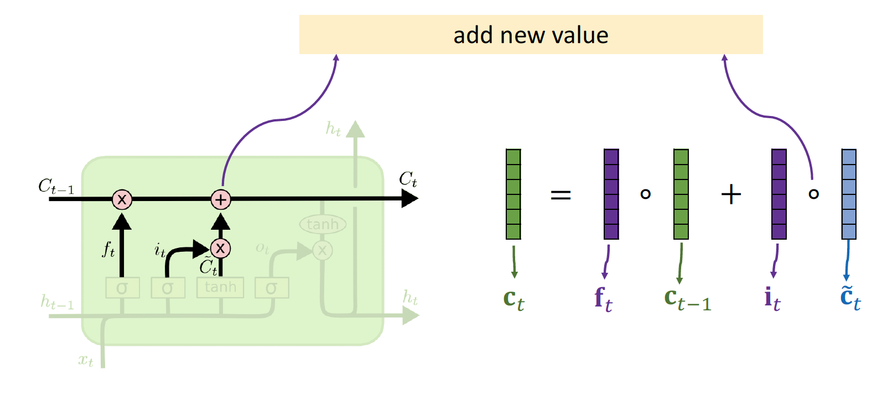
LSTM: Update the Conveyor Belt
The left figure is from Christopher Olah’s blog: Understanding LSTM Networks.

Slide 61
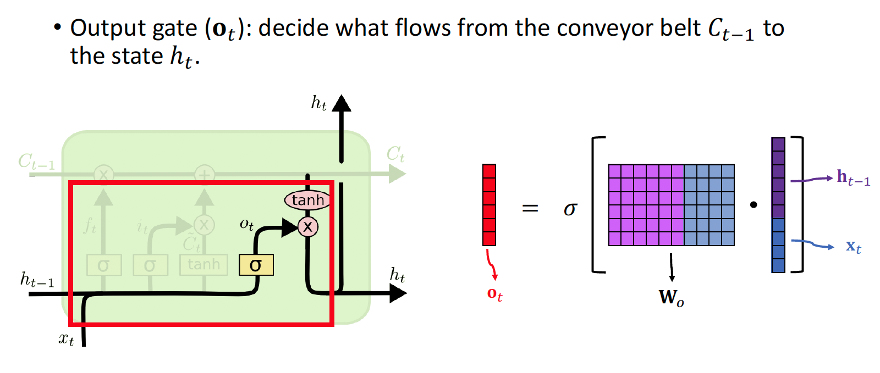
LSTM: Output Gate
The left figure is from Christopher Olah’s blog: Understanding LSTM Networks.

Slide 62
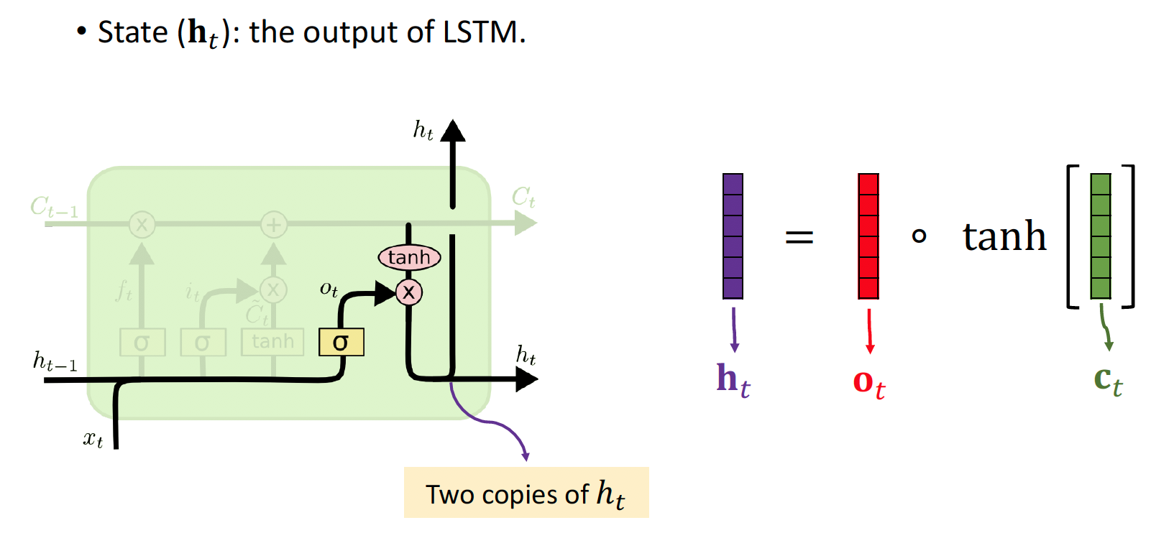
LSTM: Update State
The left figure is from Christopher Olah’s blog: Understanding LSTM Networks.

Slide 63
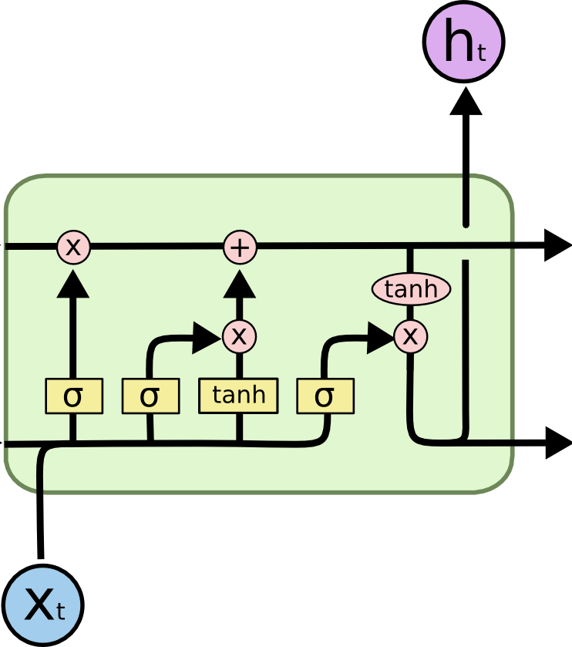
LSTM: Number of Parameters
#parameters: 4 times as many as SimpleRNN
4 parameter matrices:
f, i, c, o
The left figure is from Christopher Olah’s blog: Understanding LSTM Networks.

Slide 64
Summary
LSTM uses a “conveyor belt” to get longer memory than SimpleRNN.
Input | 7x7 conv, 64 / 2 | Pool
Pool | FC 1000 | Softmax
...
3x3 conv, 128
3x3 conv, 128
3x3 conv, 128
3x3 conv, 128
3x3 conv, 128
3x3 conv, 128 / 2
3x3 conv, 64
3x3 conv, 64
3x3 conv, 64
3x3 conv, 64
3x3 conv, 64
3x3 conv, 64
3x3 conv, 64
3x3 conv, 64
3x3 conv, 64
3x3 conv, 64
3x3 conv, 64
3x3 conv, 64
Similar to ResNet!
Uninterrupted gradient flow!

Slide 65
Summary
LSTM uses a “conveyor belt” to get longer memory than SimpleRNN.
Each of the following blocks has a parameter matrix:
Forget gate.
Input gate.
New values.
Output gate.

Slide 66
Making RNNs More Effective
1.Stacked RNN
2. Bi-directional RNN
3. Pretraining Embedding Layers

Slide 67
Stacked RNN

Slide 68
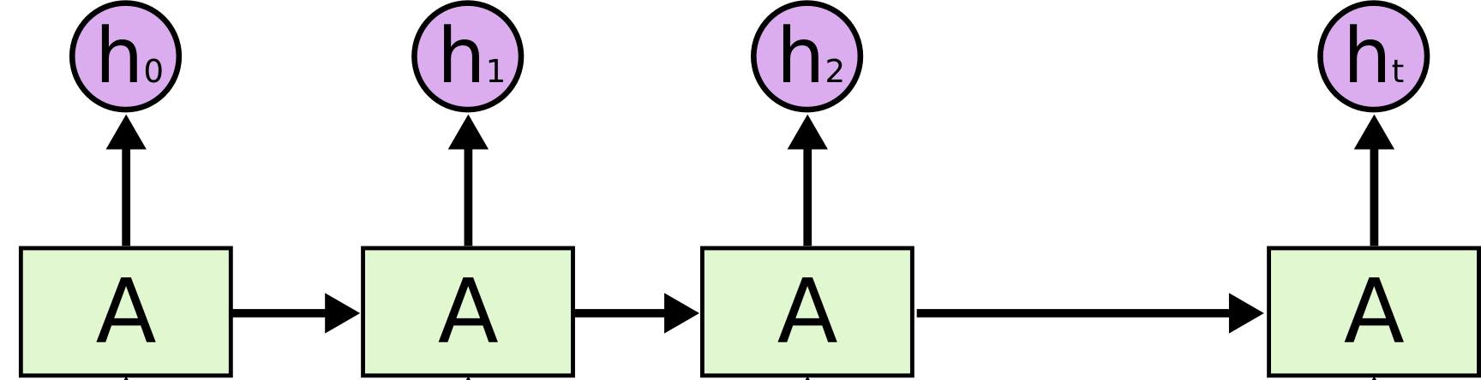
Stacked RNN
⋯
'' '' '' ''
' ' ' '
the
cat
sat
⋯
mat

Slide 69
Stacked RNN
⋯
'' '' '' ''
′
′
′
′
the cat sat ⋯

Slide 70
Stacked RNN
′′
′′ ′′
' ′
′′
′
′
i
love
the
⋯
much

Slide 71
Bidirectional RNN

Slide 72
Standard RNN
i
love
the
⋯
much

Slide 73
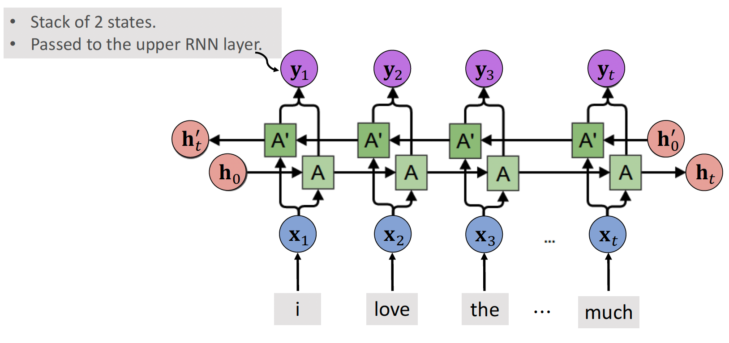
Bidirectional RNN

Slide 74
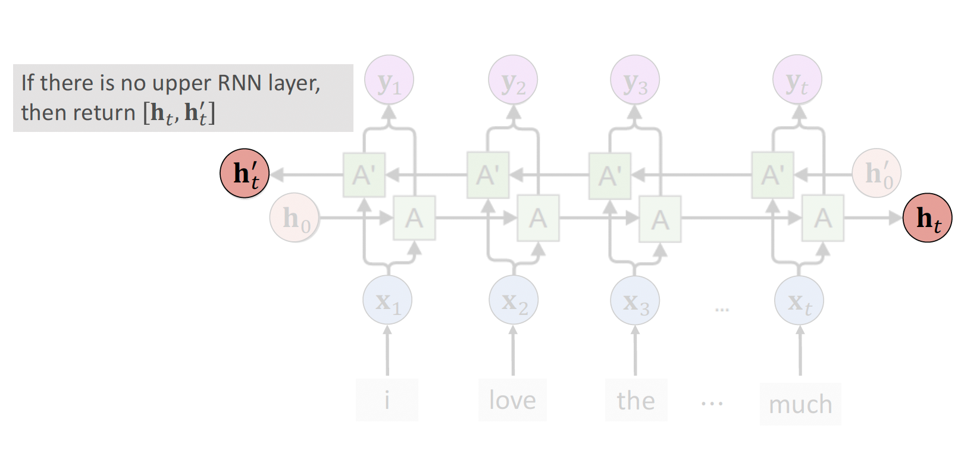
Bidirectional RNN

Slide 75
Pretrain

Slide 76
Why pretraining?
Observation: The embedding layer contributes most of the parameters!

Slide 77
Pretrain the Embedding Layer
Step 1: Train a model on large dataset.
Perhaps different problem.
Perhaps different model.
⋯
the
cat
sat
⋯
mat

Slide 78
Pretrain the Embedding Layer
Step 2: Keep only the embedding layer.
⋯
the
cat
sat
⋯
mat

Slide 79
Pretrain the Embedding Layer
Step 3: Train new LSTM and output layers.
⋯
Set the embedding layer non-trainable.
the
cat
sat
⋯
mat

Slide 80
Summary
SimpleRNN and LSTM are two kinds of RNNs; always use LSTM instead of SimpleRNN.
Use Bi-RNN instead of RNN whenever possible.
Stacked RNN may be better than a single RNN layer.
Pretrain the embedding layer.

Slide 81
Any Question ?

